Slide 1
Aug 2023
Fake News Detection
Using Logistic Regression
Intel Unnati Project
Team RazorCode, RIT

Slide 2
Problem Statement
Tools Used
Fake news detection using machine learning for reliable and accurate classification in a digital information ecosystem.
Python, SciKit, Pandas, NLTK, Jupyter Notebook
Team RazorCode
Team Members:
Mentor:
Pranshu Jha
Ravi Rohith A
Ramkishor S
Dr. O. Pandithurai
2

Slide 3

Fake News Detection
The proliferation of fake news in the digital age poses a significant threat to society, undermining trust in media and influencing public opinion.
This project explores the application of logistic regression for fake news detection, aiming to distinguish between genuine and fabricated articles with high accuracy.
3

Slide 4



Objectives
a. Accuracy Enhancement
b. Identifying Manipulation b. Techniques
c. Combat Viral Spread
d. Evaluate System
d. Performance
4

Slide 5

Logistic
Regression for
Fake News Detection
The Model
The logistic regression model employed for fake news detection achieves an impressive accuracy rate of 99.6%. The high accuracy rate demonstrates the model's robustness in accurately classifying between genuine and fabricated news. With its simplicity and interpretability, the logistic regression model proves to be a valuable tool in the fight against misinformation, providing reliable and accurate detection capabilities. The model's 99.6% accuracy underscores its effectiveness in addressing the challenges posed by fake news in today's digital landscape.
5
5

Slide 6

Architecture
Steps
1. Data Collection
2. Preprocessing
3. Feature Extraction
4. Logistic Regression Model
5. Model Evaluation
6. Model Optimization
7. Deployment and Integration
6

Slide 7
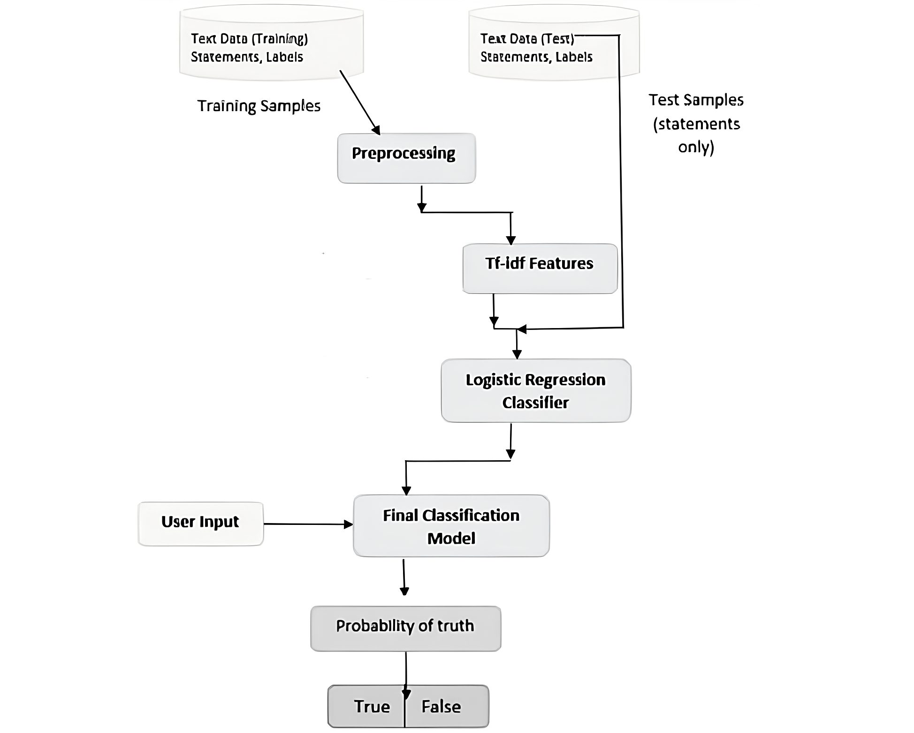
Architecture
Diagram
7

Slide 8

Software Model
Elements of The Software Model
Programming Language
Data Processing and Analysis
Machine Learning Libraries
Natural Language Processing (NLP) Libraries
Model Evaluation and Metrics
Development Environment
Deployment Framework
8

Slide 9

Conclusion
In conclusion, the logistic regression model developed
for fake news detection demonstrates remarkable accuracy,
achieving a rate of 99.6%.
By leveraging the simplicity and
interpretability of logistic regression, coupled with robust
preprocessing techniques and feature extraction, the model
effectively distinguishes between genuine and fake news
articles. This high accuracy rate underscores the potential of
logistic regression as a powerful tool in combatting
misinformation.
The findings of this research highlight the
significance of the model in contributing to the development
of reliable and accurate fake news detection system
9

Slide 10
Aug 2023
Thank you
for listening!
Intel Unnati Project
Team RazorCode, RIT

